Slide 1









Physical Education Teacher Autonomy Support Training to Promote Leisure-time Physical Activity in Students (PETALS) Intervention
Chairs:
Martin S. Hagger (University of California, Merced, USA, University of Jyväskylä, Finland),
Taru Lintunen (University of Jyväskylä, Finland)
Discussant:
Glyn C. Roberts (Norwegian School of Sport Sciences)
https://www.fidiproimpact.com/
FEPSAC 15-20 July, 2019, Münster
BUSINESS
FINLAND

Slide 2

Physical Education Teacher Autonomy Support Training to Promote Leisure-time Physical Activity in Students (PETALS) Intervention
Theoretical Basis of the PETALS Intervention Program: The Trans-Contextual Model Martin S. Hagger, Mary Hassandra, Arto Laukkanen, Juho Polet, Nelli Hankonen, Mirja Hirvensalo, Taru Lintunen
Predicting Change in Out-of-School Physical Activity Using the Trans-Contextual Model Juho Polet, Martin S. Hagger, Maiken Hansen, Taru Lintunen
Description of the Development of the Autonomy-Supportive PE Teacher Training Program (PETALS) Mary Hassandra, Arto Laukkanen, Taru Lintunen, Juho Polet, Nelli Hankonen, Mirja Hirvensalo, Martin S. Hagger
Implementation of the PETALS Intervention Teacher Training Program Arto Laukkanen, Mary Hassandra, Juho Polet, Marjo Rantalainen, Elisa Kaaja, Martin S. Hagger, Taru Lintunen
Acceptability of the Petals PE Teacher Training Programme to Promote Autonomous Motivation toward Physical Activity Taru Lintunen, Mary Hassandra, Juho Polet, Nelli Hankonen, Mirja Hirvensalo, Martin S. Hagger Discussant: Glyn C. Roberts

Slide 3



Martin Hagger, Curtin University & University of Jyväskylä
Taru Lintunen, University of Jyväskylä

Slide 4




Theoretical Basis of the PETALS Intervention Program: The Trans-Contextual Model
Martin S. Hagger^{1,2}
Mary Hassandra^{2,3}, Arto Laukkanen², Juho Polet², Nelli Hankonen⁴, Mirja Hirvensalo ², & Taru Lintunen²
¹University of California, Merced USA
²University of Jyväskylä, Finland
³University of Thessaly, Greece
⁴University of Helsinki, Finland

Slide 5
The Question
  “Does promoting motivation toward activities in school lead to increased motivation toward activities outside of school?”

Slide 6
Children’s physical activity & the value of ‘existing networks’
Challenge of promoting physical activity in children
Need to use ‘existing networks’ to maximise coverage (e.g., youth clubs, social clubs, family physicians, school)
Much focus on school Physical Education
Experiences in PE can be negative
Interventions have targeted PE to get messages across to children
Effect of promoting physical activity in PE on activity outside of school seldom examined

Slide 7
Trans-Contextual Model Propositions
Proposition 1
Proposition 2
Proposition 3
Support for
Autonomy
Physical
Activity
Beliefs &
Intentions
Autonomous
Motivation
Autonomous
Motivation
Autonomy support
Significant others
Provision of a ‘climate’ supporting autonomy
Perceived autonomy support
In-School Motivation
Autonomous motivation
Physical education context
Out-of-School Motivation
Autonomous motivation
Leisure-time context
Antecedent Beliefs from Theory of Planned Behavior (TPB; Ajzen 1985)
Attitudes
Norms
Control
Intentions
Sources: Hagger et al. (2003) Journal of Educational Psychology
Hagger & Chatzisarantis (2016) Review of Educational Research

Slide 8
Hypotheses
Autonomy support in PE will influence self-determined motives in a PE-context
Motives in PE will lead to self-determined motives in a leisure-time context
Motives in leisure-time will influence exercise, beliefs, intentions and behaviour
= A ‘motivational sequence’ (Vallerand, 2000)

Slide 9
Typical TCM Study Design
PE context
Leisure-time context
Time 1
(1) SDT:
Perceived
Autonomy
Support
(2) PLOC:
External
Introjection
Identification
Intrinsic
Time 2
(1) TPB:
Intentions
Attitudes
Subjective Norm
Perceived Control
(2) PLOC:
External
Introjection
Identification
Intrinsic
Time 3
Leisure
Time
Exercise
Behaviour
1 week
5 weeks
Time

Slide 10
Important effects
Attitude
Perceived
Autonomy
Support
Autonomous
Motives
Autonomous
Motives
Intention
Physical
Activity
Control
Time 1: Physical Education
Context
Time 3:
Physical
Activity
Behaviour
Time 2: Leisure-Time Context
Hagger, Chatzisarantis, Culverhouse, & Biddle (2003) Journal of Educational Psychology

Slide 11
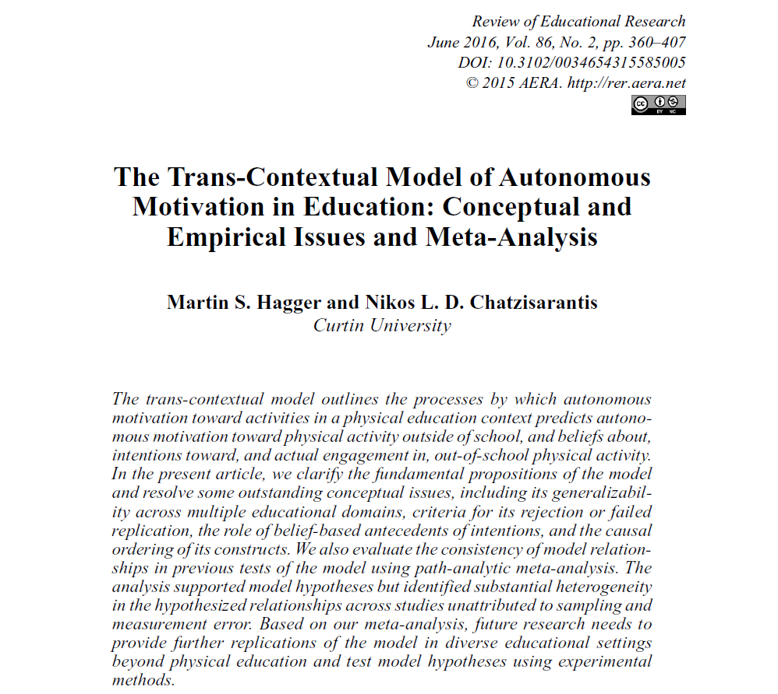
Meta-analysis
Hagger, M. S., & Chatzisarantis, N. L. D. (2016). The trans-contextual model of autonomous motivation in education: Conceptual and empirical issues and meta-analysis. Review of Educational Research, 86, 360-407. doi: 10.3102/0034654315585005

Slide 12
Study 5: Meta-analysis
Resolving controversies and questions:
  Can the TCM be rejected?
  Are beliefs necessary?
  Ordering of constructs in the model
Meta-analysis:
  19 studies, 24 tests
  Mainly focused on PE/leisure-time physical activity
  Path analysis based on corrected correlations from meta-analysis

Slide 13
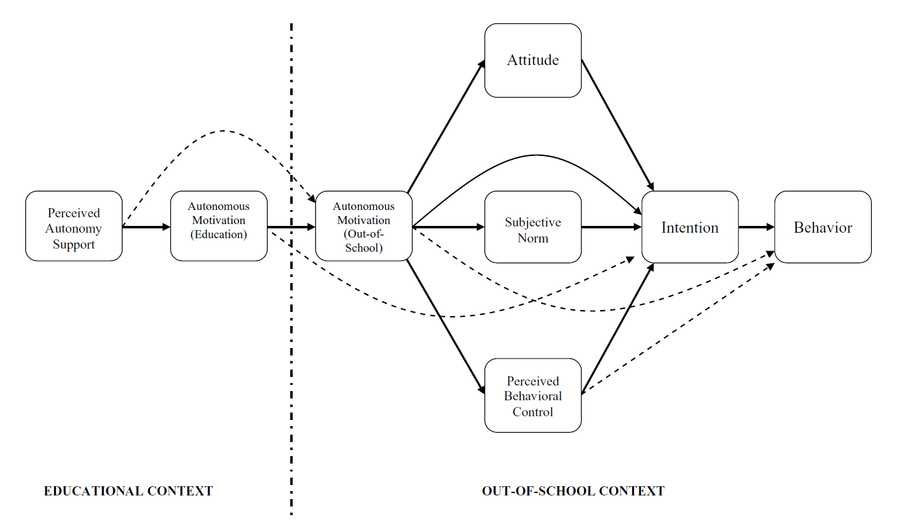
Meta-analysis

Slide 14
Summary
Support for three key propositions of TCM across multiple studies
  Autonomy support promotes autonomous motivation
  Trans-contextual of autonomous motivation
  Autonomous motivation and autonomy support determine intentions and behavior
Almost all research is correlational
Almost all research uses self-reports

Slide 15
Pilot Intervention Using TCM
Hypothesis: Aimed to support TCM hypotheses in an RCT in the field
Design: 3 intervention groups:
  TCM intervention (teachers provide autonomy support)
  TPB intervention (teachers provide belief-based support)
  Information only
Chatzisarantis & Hagger (2009) Psychology and Health

Slide 16
Step 1: Mapping of intervention components
Theory | Construct | Intervention component
TPB | Attitudes | Persuasive communication targeting SALIENT beliefs
TPB | Perceived control | Reduce BARRIERS and efficacy experience
Self-determination theory | Autonomous motivation | CHOICE, personal goals, and competence experiences

Slide 17
Step 2: Training on intervention components
Intervention components teachers provided with instruction to:
  SDT
    Adopt a democratic approach
    Provide choice
    Help set personal goals
    Encourage questioning
    Assist in personal development
    Acknowledge conflicts and difficulties
  TPB
    Emphasize salient beliefs
    Dispel disadvantages and barriers
    Promote advantages

Slide 18
Results
Path analysis
Autonomy
Support
(Intervention)
Perceived
Autonomy
Support
(Teacher)
.29
.20
Attitude
.29
.40
Intrinsic
Motivation
.20
Intention
.69
Physical
Activity
.18
Perceived
Control
.23
TPB
(Intervention)
Source: Chatzisarantis, N. L. D., & Hagger, M. S. (2009). Effects of an intervention
based on self-determination theory on self-reported leisure-time physical activity
participation. Psychology and Health, 24, 29-48.

Slide 19
Results
Provision of autonomy support (SDT) provided changes in perceived autonomy support and autonomous motivation
Belief-based (TPB) intervention changed attitudes
Both intervention components increased behaviour
Supported trans-contextual model and interventions based on the TPB
Suggestion of ‘hybrid’ models of intervention (Koestner et al., 2003; Prestwich et al., 2004)

Slide 20
Advancing the Trans-Contextual Model
Need for support in other domains such as maths homework in and out of school (e.g., Hagger et al., 2015, 2016)
Need to look at ‘change’ in model components (e.g., Polet et al., 2019)
More effective in matching components of autonomy support with theory constructs and training materials (e.g., Hassandra et al., 2019; Laukkanen et al. 2019)
Need for an acceptable intervention (e.g., Lintunen et al., 2019)

Slide 21
Thank You!
www.martinhagger.com
www.curtin.edu.au

Slide 22




Juho Polet, Taru Lintunen, Maiken Hansen, & Martin Hagger
University of Jyväskylä, Finland
Predicting Change in leisure-time Physical Activity Using the Trans-Contextual Model
www.fidiproimpact.com
Notes:
Hello, I’m Juho Polet, PhD student from the University of Jyväskylä, Finland
The topic of my talk is predicting change in leisure-time physical activity using the Trans-contextual Model
I want to thank my supervisors and collaborators
Congratelate fepsac for birthday

Slide 23
Rationale
Decreasing levels of physical activity during adolescent years reported internationally in epidemiological data (Sallis, 2000, Dumith et al. 2011).
  Decline is most dramatic in non-organized activities, between ages 13-18
In Finland:
  41 % of 11-year old students
  17 % of 15-year old students
  Meet guidelines for physical activity (Kokko et al., 2016).
Physical education (PE) in secondary school is a potentially useful existing network to promote physical activity
Notes:
We have same trend in Finland with quite a drastic drop in physicial from pre-teen years to teen years
We have physical education as compulsory subject in school – can we do something there?

Slide 24

The Trans-Contextual Model (Hagger et al., 2003).
An integrated theoretical model that is used to outline:
  How students’ perceptions of PE teachers’ support for their autonomous motivation in class
  promotes their motivation and intention to engage in free-time physical activity
Proposition:
Teachers can promote students’ leisure-time physical activity by applying autonony supportive teaching techniques
Notes:
TCM draws from Self-Determination theory, Vallerand’s theory of hierarchical model of motivation and theory of planned behaviour
Bacground for study is transcontextual model

Slide 25
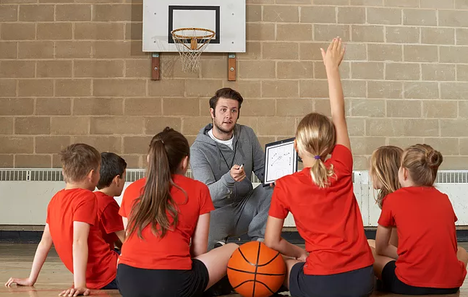
What is autonomy supportive teaching?
Taking student’s perspective
Using non-controlling and informational language
Providing a rationale
Displaying patience
Providing choices
Accepting negative emotions and feelings
Notes:
Common for autonomy supportive teaching taking student’s perspective in instruction
Displaying patience > for example giving appropriate time for student to conducts exercise

Slide 26
Trans-contextual Model
.
Participating in active sports and/or vigorous physical activities during my leisure time would be
Unenjoyable – enjoyable
Bad – good
Useless – useful
My PE teacher tries to understand how I see things before suggesting a new way to do things
I do PE/PA:
because I enjoy PE/PA
Because I value the benefits of physical activity
Attitude
Perceived
Autonomy
Support in PE
Autonomous
Motivation
(PE)
Autonomous
Motivation
(leisure-time)
Subjective
Norm
Intention
Physical Activity
Behavior
Most people who are important to me think I should do active sports and/or vigorous physical activities during my leisure time
Perceived
Behavioral
Control
I intend to do active sports and/or vigorous physical activities during my leisure time
I am confident I could do active sports and/or vigorous physical activities during
my leisure time
.
I attended in physical activities X times during the last Y weeks
EDUCATIONAL CONTEXT
LEISURE-TIME CONTEXT
Notes:
I present each construct of the model here with an example item how that construct is measured.
Attitudes reflect an individual’s positive and negative evaluations of a target behaviour
Subjective norms reflect an individual’s beliefs that significant others want them to participate in the behaviour
Perceived behavioral control reflects individuals’ personal evaluations of their capacity to perform the behaviour

Slide 27
Trans-contextual Model
.
Attitude
Perceived
Autonomy
Support in PE
Autonomous
Motivation
(PE)
Autonomous
Motivation
(leisure-time)
Subjective
Norm
Intention
Physical Activity
Behavior
Perceived
Behavioral
Control
.
EDUCATIONAL CONTEXT
LEISURE-TIME CONTEXT
Notes:
Here you see the model without those example items

Slide 28
The Trans-Contextual Model
Multiple studies have supported the predictions of TCM including:
  Narrative review (Hagger & Chatzisarantis, 2012)
  Meta-analysis (Hagger & Chatzisarantis, 2016)
The current study extends previous research on TCM by testing whether the model is efficacious in predicting change in its constructs over time.
  Predicting change moves explanations from the static predictions to dynamic prediction
Static prediction
Dynamic prediction
  How variables are related to each other (at the same measurement point)
How change in one variable over time effects on change in another variable over time
Explanation goes over mere stability
Notes:
There is relatively strong empirical support for the model
The biggest contribution of our research is to extend the model predictions over mere stability

Slide 29

Aim
Does naturally occurring change within Trans-Contextual Model in perceived autonomy support from PE teacher have effect on lower-secondary school students’ leisure-time physical activity?
Notes:
If change in perceived autonomy support in PE has effect on change in motivation and leisure time physical activity
We were interested in naturally occurring change

Slide 30
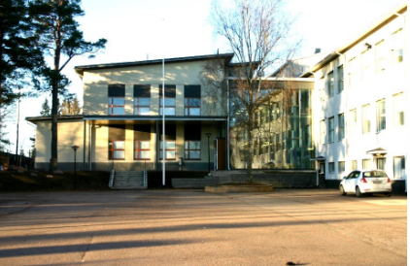
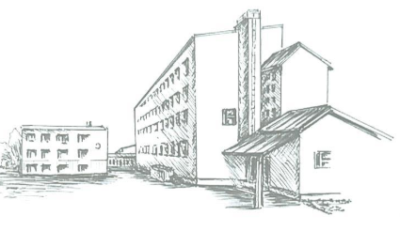
Study was conducted in two Lower-Secondary schools in Eastern Finland
121 students (7th-9th graders)
56 boys, 65 girls
127 students (7th-9th graders)
62 boys, 65 girls
Total amount of participants 248 (15 % attrition)
T1
T2
T3
September 2017
October 2017
November 2017
Three-wave longitudinal design
Notes:
Other school was in colours and other was black and white
Not intervention study, but we were interested in naturally occurring change in measured variables in three time points. The follow-up time was ten weeks in total

Slide 31
Used measures alongside the design
T1 | T2 (5 weeks after T1) | T3 (10 weeks after T1)
Perceived autonomy support from PE teacher (Hagger et al., 2007) | Perceived autonomy support from PE teacher (Hagger et al., 2007)
Autonomous motivation towards PE (Ryan & Connell, 1989) | Autonomous motivation towards PE (Ryan & Connell, 1989)
Autonomous motivation towards free-time PA (Ryan & Connell, 1989) | Autonomous motivation towards free-time PA (Ryan & Connell, 1989)
Attitudes towards free-time PA (Ajzen, 2002) | Attitudes towards free-time PA (Ajzen, 2002)
Subjective norm towards free-time PA (Ajzen, 2002) | Subjective norm towards free-time PA (Ajzen, 2002)
Perceived behavioural control towards free-time PA (Ajzen, 2002) | Perceived behavioural control towards free-time PA (Ajzen, 2002)
Intention towards free-time PA (Ajzen, 2002) | Intention towards free-time PA (Ajzen, 2002)
PA behaviour (free-time) (Godin & Shephard, 1985) | PA behaviour (free-time) (Godin & Shephard, 1985) | PA behaviour (free-time) (Godin & Shephard, 1985)
T1 (All constructs measured)
T2 (All constructs measured)
T3 (Only PA measured)
Three-wave longitudinal design
Notes:
Here are the measures alongside the design, that I previously showed

Slide 32
How to account for the change when there are multiple points of measurement?
Simple subtraction (T2-T1) does not work because we have measured physical activity also at T3
Our solution:
Each variable measured at T2 was regressed on its T1 measure
Physical activity measured at T3 was regressed on its T2 and T1 measure
As the results of regressions we obtained residual change scores
Model prediction were tested by using residual change scores in path analysis
Notes:
We don’t want to use different change score for those variables that were measured at T1 and T2 only and then different change score for physical activity that was measured at T1, T2 and T3

Slide 33
Trans-contextual Model for residualized change scores
.
Attitude
.06
.09
.21***
.33***
.34***
Perceived
Autonomy
Support
Autonomous
Motivation
(PE)
Autonomous
Motivation
(Leisure-time)
.20**
Subjective
Norm
Intention
.15*
Physical Activity
Behavior
.29***
.40***
.15*
.00
.05
-.15*
.10
.40***
Perceived
Behavioral
Control
.12
Χ² (9) = 21.84; p = .009
RMSEA = .076 [.035 – .117]
CFI = .956; TLI = .864
EDUCATIONAL CONTEXT
FREE-TIME CONTEXT
Notes:
This is path model of TCM – each box represents change in that variable
Solid line: 1) significant effect: Model predictions concerning significant effects were confirmed except for perceived behavioral control did not predict intention and it predicted physical activity negatively
2) Autonomous motivation in leisure time was better predictor of intention than attitude, subjective norm and perceived behavioural control (theory of planned behaviour states attitutudes, norms and PBC to be the most proximal predictors of intention)
3) Intention was only marginally significant predictor of physical activity with small effect size
Dashed line: insignificant effect these were as model predicts (except for perceived behavioural control still not predicting intention)

Slide 34
.
Attitude
.06
.09
.21***
.34***
.33***
Perceived
Autonomy
Support
Autonomous
Motivation
(PE)
Autonomous
Motivation
(Leisure-time)
.20**
Subjective
Norm
Intention
.15*
Physical Activity
Behavior
.29***
.40***
.15*
.00
.05
.12
.10
-.15*
.40***
Perceived
Behavioral
Control
EDUCATIONAL CONTEXT
LEISURE-TIME CONTEXT
Effect summary (β)
Perceived autonomy supportAut.motivation PEAut.motivation leisure-time | 12**
Aut.motivation leisure timeAttitudeIntention | .07*
Aut.motivation leisure timeSubjective normIntention | .03*
Perceived autonomy supportIntention (total) | .17**
Perceived autonomy supportPhysical activity behaviour (total) | .14*
Notes:
Next I take a short look on indirect effects and total effects
Again keep in mind that i speak about change over time within

Slide 35
.
Attitude
.21***
.34***
.33***
Perceived
Autonomy
Support
Autonomous
Motivation
(PE)
Autonomous
Motivation
(Leisure-time)
.20**
Subjective
Norm
Intention
.15*
Physical Activity
Behavior
.29***
.40***
.15*
.10
-.15*
.40***
Perceived
Behavioral
Control
EDUCATIONAL CONTEXT
LEISURE-TIME CONTEXT
Effect summary (β)
Perceived autonomy supportAut.motivation PEAut.motivation leisure-time | 12**
Aut.motivation leisure timeAttitudeIntention | .07*
Aut.motivation leisure timeSubjective normIntention | .03*
Perceived autonomy supportIntention (total) | .17**
Perceived autonomy supportPhysical activity behaviour (total) | .14*
Notes:
This indirect effects represents how the effect of perceived autonomy support on autonomous motivation in leisure time is fully mediated by autonomous motivation in PE.
Support for the transcontextual shift of motivation

Slide 36
.
Attitude
.21***
.34***
.33***
Perceived
Autonomy
Support
Autonomous
Motivation
(PE)
Autonomous
Motivation
(Leisure-time)
.20**
Subjective
Norm
Intention
.15*
Physical Activity
Behavior
.29***
.40***
.15*
.10
-.15*
.40***
Perceived
Behavioral
Control
EDUCATIONAL CONTEXT
LEISURE-TIME CONTEXT
Effect summary (β)
Perceived autonomy supportAut.motivation PEAut.motivation leisure-time | 12**
Aut.motivation leisure timeAttitudeIntention | .07*
Aut.motivation leisure timeSubjective normIntention | .03*
Perceived autonomy supportIntention (total) | .17**
Perceived autonomy supportPhysical activity behaviour (total) | .14*

Slide 37
.
Attitude
.21***
.34***
.33***
Perceived
Autonomy
Support
Autonomous
Motivation
(PE)
Autonomous
Motivation
(Leisure-time)
.20**
Subjective
Norm
Intention
.15*
Physical Activity
Behavior
.29***
.40***
.15*
.10
-.15*
.40***
Perceived
Behavioral
Control
EDUCATIONAL CONTEXT
LEISURE-TIME CONTEXT
Effect summary (β)
Perceived autonomy supportAut.motivation PEAut.motivation leisure-time | 12**
Aut.motivation leisure timeAttitudeIntention | .07*
Aut.motivation leisure timeSubjective normIntention | .03*
Perceived autonomy supportIntention (total) | .17**
Perceived autonomy supportPhysical activity behaviour (total) | .14*

Slide 38
.
Attitude
.21***
.34***
.33***
Perceived
Autonomy
Support
Autonomous
Motivation
(PE)
Autonomous
Motivation
(Leisure-time)
.20**
Subjective
Norm
Intention
.15*
Physical Activity
Behavior
.29***
.40***
.15*
.10
-.15*
.40***
Perceived
Behavioral
Control
EDUCATIONAL CONTEXT
LEISURE-TIME CONTEXT
Effect summary (β)
Perceived autonomy supportAut.motivation PEAut.motivation leisure-time | 12**
Aut.motivation leisure timeAttitudeIntention | .07*
Aut.motivation leisure timeSubjective normIntention | .03*
Perceived autonomy supportIntention (total) | .17**
Perceived autonomy supportPhysical activity behaviour (total) | .14*

Slide 39
.
Attitude
.21***
.34***
.33***
Perceived
Autonomy
Support
Autonomous
Motivation
(PE)
Autonomous
Motivation
(Leisure-time)
.20**
Subjective
Norm
Intention
.15*
Physical Activity
Behavior
.29***
.40***
.15*
.10
-.15*
.40***
Perceived
Behavioral
Control
EDUCATIONAL CONTEXT
LEISURE-TIME CONTEXT
Effect summary (β)
Perceived autonomy supportAut.motivation PEAut.motivation leisure-time | 12**
Aut.motivation leisure timeAttitudeIntention | .07*
Aut.motivation leisure timeSubjective normIntention | .03*
Perceived autonomy supportIntention (total) | .17**
Perceived autonomy supportPhysical activity behaviour (total) | .14*

Slide 40

Notes:
I hope that results discussed are a bit more clear than this picture

Slide 41
Student’s perceived autononomy support in PE predicted autonomous motivation for PE
.
Attitude
.21***
.34***
.33***
Perceived
Autonomy
Support
Autonomous
Motivation
(PE)
Autonomous
Motivation
(Leisure-time)
.20**
Subjective
Norm
Intention
.15*
Physical Activity
Behavior
.29***
.40***
.15*
.10
-.15*
.40***
Perceived
Behavioral
Control
EDUCATIONAL CONTEXT
LEISURE-TIME CONTEXT
Notes:
Change over time

Slide 42
The model predicted trans-contextual change of autonomous motivation between PE and free-time physical activity
.
Attitude
.21***
.34***
.33***
Perceived
Autonomy
Support
Autonomous
Motivation
(PE)
Autonomous
Motivation
(Leisure-time)
.20**
Subjective
Norm
Intention
.15*
Physical Activity
Behavior
.29***
.40***
.15*
.10
-.15*
.40***
Perceived
Behavioral
Control
EDUCATIONAL CONTEXT
LEISURE-TIME CONTEXT
Notes:
Critical common method variance

Slide 43
Autonomous motivation for free-time PA predicted social cognitive constructs
.
Attitude
.21***
.34***
.33***
Perceived
Autonomy
Support
Autonomous
Motivation
(PE)
Autonomous
Motivation
(Leisure-time)
.20**
Subjective
Norm
Intention
.15*
Physical Activity
Behavior
.29***
.40***
.15*
.10
-.15*
.40***
Perceived
Behavioral
Control
EDUCATIONAL CONTEXT
LEISURE-TIME CONTEXT

Slide 44
Autonomous motivation for leisure time PA predicted intention better than social cognitive constructs
.
Attitude
.21***
.34***
.33***
Perceived
Autonomy
Support
Autonomous
Motivation
(PE)
Autonomous
Motivation
(Leisure-time)
.20**
Subjective
Norm
Intention
.15*
Physical Activity
Behavior
.29***
.40***
.15*
.10
-.15*
.40***
Perceived
Behavioral
Control
EDUCATIONAL CONTEXT
LEISURE-TIME CONTEXT

Slide 45
Intention predicted behaviour only marginally
.
Attitude
.21***
.34***
.33***
Perceived
Autonomy
Support
Autonomous
Motivation
(PE)
Autonomous
Motivation
(Leisure-time)
.20**
Subjective
Norm
Intention
.15*
Physical Activity
Behavior
.29***
.40***
.15*
.10
-.15*
.40***
Perceived
Behavioral
Control
EDUCATIONAL CONTEXT
LEISURE-TIME CONTEXT

Slide 46
Limitation: -Correlational design
-Short follow-up for naturally occurring changes
.
Attitude
.21***
.34***
.33***
Perceived
Autonomy
Support
Autonomous
Motivation
(PE)
Autonomous
Motivation
(Leisure-time)
.20**
Subjective
Norm
Intention
.15*
Physical Activity
Behavior
.29***
.40***
.15*
.10
-.15*
.40***
Perceived
Behavioral
Control
EDUCATIONAL CONTEXT
LEISURE-TIME CONTEXT

Slide 47
Take-home message
Research on models predicting behaviour would benefit from applying more dynamic view toward its constructs
  How change in one construct is related to change in another construct
Challenge for further research:
  How to intervene motivation, beliefs and intentions so that also behaviour is effected?

Slide 48
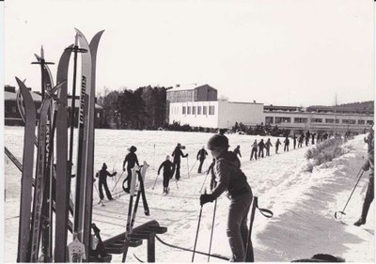
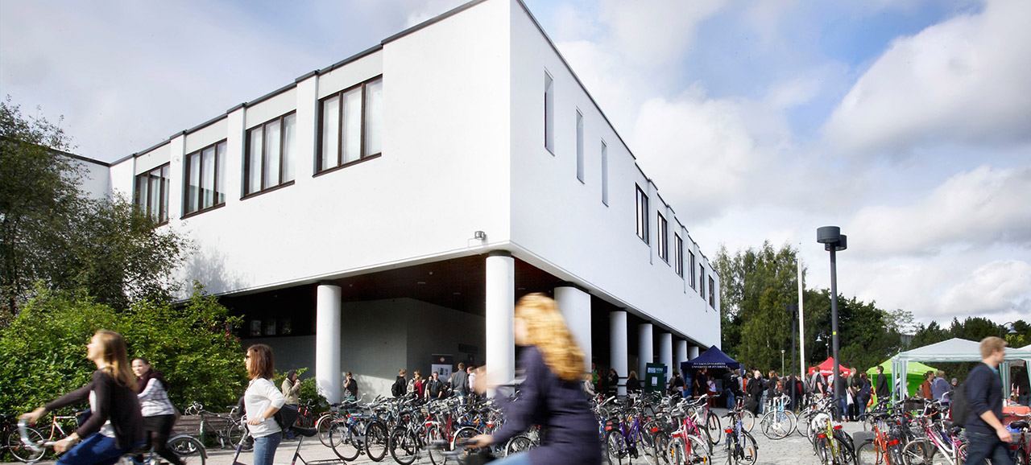

Danke Schön!
Thank you!

Slide 49
FEPSAC 2019

Slide 50

Description of the Development of the Autonomy-Supportive PE Teacher Training
Program (PETALS)
Mary Hassandra, Arto Laukanen, Taru Lintunen, Juho Polet, Nelli Hankonen, Mirja Hirvensalo, Martin S. Hagger
FEPSAC 2019

Slide 51
Aim
PETALS
Physical Education Teacher- training program, targeting the promotion of students’ perceived Autonomy to be more physicaLly active out of School

Slide 52
1st stage
Review of literature and best practices

Slide 53
1st stage: Review of literature and best practices
A. Identification of the most effective autonomy supportive techniques
  Review of current evidence (Reeve, 2009; 2004; Aelterman, 2015)
B. Means to deliver techniques to PE teachers
  Acquired teacher training materials from existing autonomy support training programs and previous interventions (Cheon et al., 2012, Hankonen, 2017).

Slide 54
A. Autonomy-supportive teaching techniques
1. Taking students' perspective
2. Providing explanatory rationales
3. Using non-controlling and informational language
4. Acknowledging negative feelings and emotions
5. Displaying patience
6. Providing choices
7. Using questions and answers

Slide 55

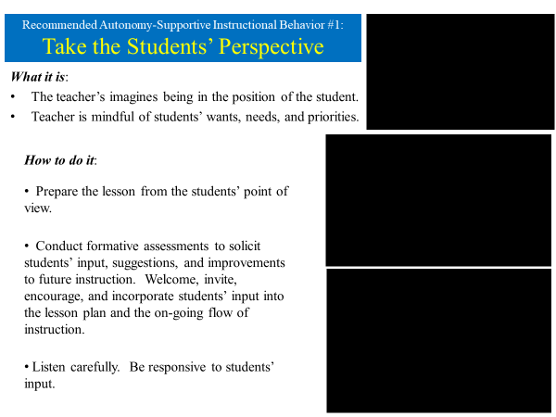
B. Example of acquired material
Reeve’s material: Presentation with video examples

Slide 56
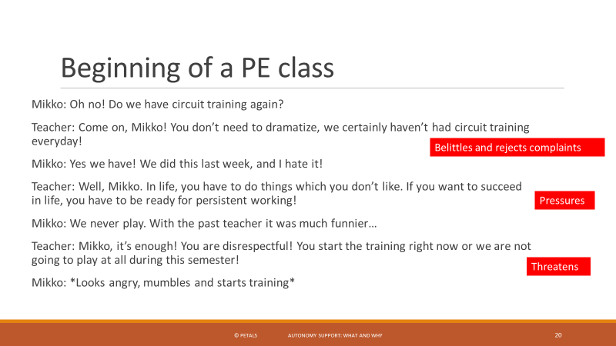
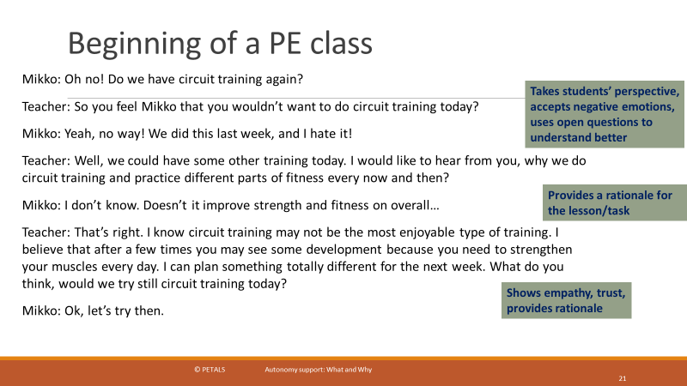
B. Example of acquired material
Hankonen’s material: Presentation with activities

Slide 57
Some decision examples during stage 1…???
AST Training in blocks to give teachers the opportunity to apply techniques and discuss to next sessions.
Have professional PE teacher trainers to delivery the training (not the researchers)
More?...

Slide 58
2nd stage
Contents and delivery techniques

Slide 59
2nd stage: Contents and delivery techniques
The second stage involved the development of a detailed draft of the content of each session (n=6) including aims, learning outcomes, main instructional points, examples, and interactive activities.
Accompanying supportive materials (worksheets, printed examples, video demonstrations, presentation slides, and session’s summaries) were produced to illustrate the program content.
During this stage the content and materials was reviewed and revised by the core research team.

Slide 60
2nd stage: Contents and delivery techniques
6 Sessions Contents
A mapping exercise was used to guide the development of contents and delivery techniques
1. Introduction info and added value of the training to their teaching practice
2. AST (Autonomy Sup. Techniques) - Information provision & Change talk activities
3. AST - Providing instructions (technical-tactical-organisational)
4. AST - Providing Feedback, Encouragement and Praise
5. Responding to students low motivation (Discipline & Off-task behaviours)
6. Building personalised AST action plans

Slide 61
Activities and delivery techniques?
PE teacher training
PE teacher intervention
SDT techniques
AST techniques
Researchers / Trainers
P.E. Students
P.A. Motivation and Behavior
P.E. teachers
Assessments
Training activities and delivery techniques precisely matched the theory-based motivational determinants (e.g., autonomous motivation, psychological need satisfaction) targeted in the intervention guided by an initial taxonomy of self-determination theory techniques (Teixeira et al., 2016).

Slide 62
Session | Topic | What: Activities | Why: Purpose | How: Supporting material | How: MBCTs | Increase PE teachers' behaviours | Decrease PE teachers' behaviours | Teachers’ self reports | Students' self reports
Providing instructions | AST: Offer choices | Group discussions to generate ideas on how to provide choices to support students autonomy | … to generate own ideas on how in practice they can provide choices when giving instructions
What & Why?

Slide 63
Training delivery techniques:
Motivational Behaviour Change techniques (MBCTs) Teixeira et al., 2016
How?
Autonomy
Competence
Relatedness
Adopt non-controlling, informational language
Explore life aspirations and values
Facilitate autonomous goals or outcomes
Clarify expectations
Help develop a clear and concrete plan of action
Offer concrete, clear, and relevant feedback
Use attentive, reflective listening
Acknowledge and respect perspectives
Encourage asking of questions

Slide 64
Session | Topic | What: Activities | Why: Purpose | How: Supporting material | How: MBCTs | Increase PE teachers' behaviours | Decrease PE teachers' behaviours | Teachers’ self reports | Students' self reports
Providing instructions | AST: Offer choices | Group discussions to generate ideas on how to provide choices to support students autonomy | … to generate own ideas on how in practice they can provide choices when giving instructions | Complete concrete behaviours /activities on Form D “How to give more AS instructions” | Facilitate autonomous goals or outcomes
How?

Slide 65
Students' Self report of autonomy support and control
Expected
Changes
on …
Perceived autonomy support (PE class)
  … My PE teacher encourages me to do physical activity.
Perceived Control
  … My PE teacher tries to control everything I do.
Perceived autonomy support (Leisure time PA)
  … My PE teacher encourages me to do physical activity in my free time.

Slide 66
Teacher's Self report of autonomy support provision and control
Expected
Changes
on …
Provision of Autonomy support
  … I feel that I provide choices and options to my physical education students.
Link for Leisure-time PA
  … I encourage my PE students to think about how physical activity during PE class can be useful to them during their free time.
Providing rationales
  … I explain to my PE students why we learn certain things during PE class
Controlling
  … I always have to tell my PE students what to do.

Slide 67
Teachers' Observed verbal behaviour categories
Expected
Changes
on …
A. Instructions (Autonomous & Controlling)
  Verbal communication related to organizational, technical and tactical instructions (statements, questions, answers, commands etc…).
B. Praise and Encouragement (Autonomous & Controlling)
  Verbal communication aiming to provide students praise and encouragement, both on outcome and procedure
C. Dealing with misbehaviour (Autonomous & Controlling)
  Verbal communication aiming to deal with discipline (on or off task related)
D. Links with Out of school PA (Autonomous)
  Verbal communication aiming to explicitly highlight the links between PE class and out of school PA
E. Provision of explanatory rationales (Autonomous)
  Verbal communication aiming to provide rationales

Slide 68
Session | Topic | What: Activities | Why: Purpose | How: Supporting material | How: MBCTs | Increase PE teachers' behaviours | Decrease PE teachers' behaviours | Teachers’ self reports | Students' self reports
Providing instructions | AST: Offer choices | Group discussions to generate ideas on how to provide choices to support students autonomy | … to generate own ideas on how in practice they can provide choices when giving instructions | Complete concrete behaviours /activities on Form D “How to give more AS instructions” | Facilitate autonomous goals or outcomes | “perhaps try…” or “think about…”, “consider…”, “what about…” | Directive statements such as “do”, “move”, “put”, “turn”, or “place” | “I feel that I provide choices and options to my physical education students” | “I feel that PE teacher provides me with choices, options, and suggestions”
Expected
Changes
on Measures

Slide 69
3rd stage
External review

Slide 70
3rd stage: External review
The final stage involved review of the entire program and materials by external stakeholders and teacher educators, with different relevant expertise.
Based on their feedback the program content and materials further revised by the research team resulting in the final PETALS autonomy support training program.

Slide 71
Next presentation from …

Slide 72
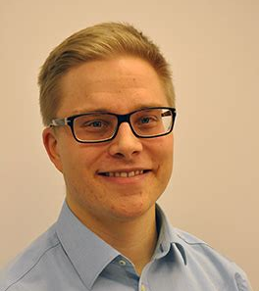
Arto Laukkanen
Post-doctoral researcher, Sport Pedagogy, JYU
Implementation of the PETALS Intervention Teacher Training Program

Slide 73
IMPLEMENTATION OF THE PETALS INTERVENTION TEACHER TRAINING PROGRAM
Arto Laukkanen
Phd, post-doctoral researcher
University of Jyväskylä, Faculty of Sport and Health Sciences, Finland
FEPSAC 2019 - 15th Congress of Sport & Exercise Psychology, Münster, Germany.
Symposium: Physical Education Teacher Autonomy Support Training to Promote Leisure-time Physical Activity in Students (PETALS) Intervention

Slide 74
Outline
IMPLEMENTATION
Physical education teacher training programme
Participants
Contents and learning outcomes
Feedback during training

Slide 75
Outline
IMPLEMENTATION
Physical education teacher training programme
Participants
Contents and learning outcomes
Feedback during training

Slide 76
Participants of the training programme
IMPLEMENTATION
16 secondary school physical education (PE) teachers in this investigation (29 teachers altogether)
7 female and 9 male PE-teachers

Slide 77
Outline
IMPLEMENTATION
Physical education teacher training programme
Participants
Contents and learning outcomes
Feedback during training

Slide 78
General aim
IMPLEMENTATION
The program aimed to familiarize physical education (PE) teachers with techniques aimed at promoting students’ autonomous motivation toward out-of-school physical activities

Slide 79
Contents and learning outcomes
IMPLEMENTATION
Session | CONTENT | LEARNING OUTCOME Teacher should be able to
1 | Introduction info and added value of the training to their teaching practice | - Identify differences in inner and external motivation - Identify differences in autonomy-supportive and controlling teaching
2 | Autonomy Sup. Techniques (AST) - Information provision & Change talk activities | - Name seven key techniques of autonomy-supportive teaching (AST)
3 | AST - Providing instructions | - Identify instructional practices in which AST could be used - Organize and communicate lesson practices in a way which supports students’ feeling of autonomy
4 | AST - Providing Feedback, Encouragement and Praise | - Identify situations relating to feedback, encouragement and praise in which AST could be used - Communicate feedback, encouragement and praise in a way that supports student’s feeling of autonomy
5 | Responding to students Discipline & Off-task behaviours | - Identify situations relating to students’ misbehavior and motivational problems in which AST could be used
6 | Building personalised AST action plans | - Plan and apply autonomy supportive teaching practices in their everyday PE teaching routine

Slide 80
Autonomy-supportive teaching:
Seven key techniques
IMPLEMENTATION
Taking the students’ perspective – common denominator for all the techniques
Providing rationale
Using non-controlling language
Using informational language
Acknowledging negative emotions and feelings
Displaying patience
Providing choices
Using questions and answers

Slide 81
Contents and learning outcomes
IMPLEMENTATION
Session | CONTENT | LEARNING OUTCOME Teacher should be able to
1 | Introduction info and added value of the training to their teaching practice | - Identify differences in inner and external motivation - Identify differences in autonomy-supportive and controlling teaching
2 | Autonomy Sup. Techniques (AST) - Information provision & Change talk activities | - Name seven key techniques of autonomy-supportive teaching (AST)
3 | AST - Providing instructions | - Identify instructional practices in which AST could be used - Organize and communicate lesson practices in a way which supports students’ feeling of autonomy
4 | AST - Providing Feedback, Encouragement and Praise | - Identify situations relating to feedback, encouragement and praise in which AST could be used - Communicate feedback, encouragement and praise in a way that supports student’s feeling of autonomy
5 | Responding to students Discipline & Off-task behaviours | - Identify situations relating to students’ misbehavior and motivational problems in which AST could be used
6 | Building personalised AST action plans | - Plan and apply autonomy supportive teaching practices in their everyday PE teaching routine

Slide 82
Key techniques when providing instructions
Example>
Providing rationale
Using non-controlling language
Using informational language
Acknowledging negative emotions and feelings
Displaying patience
Providing choices
Using questions and answers
These techniques are used to:
PROVIDE INSTRUCTIONS TO STUDENTS Session 3
PROVIDE FEEDBACK, ENCOURAGEMENT AND PRAISE TO STUDENTS Session 4
RESPOND TO STUDENTS’ MISBEHAVIOR (DISCIPLINE, LOW MOTIVATION & OFF-TASK BEHAVIORS) Session 5
Notes:
So here the key techniques in purple which we are going to practice in session 3.
These all relate to the way how instructions are provided.
B. Techniques: Definitions and examples
How to promote autonomy: What are the 6 specific autonomy-supportive teaching techniques – and short examples from PE teaching practice of techniques examples
Aims:
…to describe each technique, give examples, explain how it works
Supporting material:
Power point, videos ←WHAT’S THE “ETC.”?
Behavior Change Techniques:
Demonstration of the behavior;
Shaping knowledge.

Slide 83
Providing a rationale for out-of-school physical activity
Verbal statements (or questions) to help student(s) understand “how” some of the physical education activities have utility for their out-of-school physical activity. Explanations to help students transform (i.e., internalize) something not worth doing into something worth doing—something worth their time, attention, and effort.
  “Can you think of some applications of this activity to an out of school context? (where, when, with whom etc.)”
  “Can you find ways how this learnt thing helps you in everyday life? (e.g. orienteering)”
Notes:
Highlight here also that this technique is excellent to use when we want to promote students’ leisure time physical activity.
Ask teachers to think for examples on what kind of rationales can be used during teaching PE class that can highlight to the students
the usefulness of what they learn and practice now, in class, to their leisure time physical activity.
Aim is to find out:
“What would be the reasons for students’ to engage in this task/activity?”

Slide 84



Group discussions to generate ideas on how to provide rationales to motivate students for in-class and out of school physical activity
  “What would be the reasons for students’ to engage in the task/activity?”
“I have a clear meaning/reason for the things we are doing!”
When you give instructions in gymnastics class, how you can provide a rationale for the benefits related to out-of-school (leisure time) physical activity, health and well-being?
Notes:
Here some ideas and stimulus for group discussion (5 minutes) and filling Form D.
Make sure that rationales are not undermining instead of supporting students’ perceived autonomy.
For example,
…because is good for you…..
…because I say so…
…because that is the right thing to do…
They are rationales , but not at all autonomy supportive…

Slide 85
Contents and learning outcomes
IMPLEMENTATION
Session | CONTENT | LEARNING OUTCOME Teacher should be able to
1 | Introduction info and added value of the training to their teaching practice | - Identify differences in inner and external motivation - Identify differences in autonomy-supportive and controlling teaching
2 | Autonomy Sup. Techniques (AST) - Information provision & Change talk activities | - Name seven key techniques of autonomy-supportive teaching (AST)
3 | AST - Providing instructions | - Identify instructional practices in which AST could be used - Organize and communicate lesson practices in a way which supports students’ feeling of autonomy
4 | AST - Providing Feedback, Encouragement and Praise | - Identify situations relating to feedback, encouragement and praise in which AST could be used - Communicate feedback, encouragement and praise in a way that supports student’s feeling of autonomy
5 | Responding to students Discipline & Off-task behaviours | - Identify situations relating to students’ misbehavior and motivational problems in which AST could be used
6 | Building personalised AST action plans | - Plan and apply autonomy supportive teaching practices in their everyday PE teaching routine

Slide 86
E.G. THE FOLLOWING KEY TECHNIQUES CAN BE USED WHEN…
  “Great job, would you like it still to fly even farther?” Ok, then you can try…
  “Good job, you searched for the open space nicely!” “That was a great idea / move!”
Providing rationale
Using non-controlling language
Providing informational language
Acknowledging negative emotions and feelings
Displaying patience
Providing choices
Using questions and answers
WE PROVIDE FEEDBACK, ENCOURAGEMENT AND PRAISE
“Good, take your time!”
"I'm going to leave this up to you to discover on your own"
Notes:
The key techniques are lectured still after discussions, and possibility for further discussion is still kept open.

Slide 87
Learning Café / providing feedback, encouragement and praise
3 control points, in each point a different task (approx. 5 mins/point)
Write up your ideas on the papers in the control points
The group last in a control point reads aloud all the ideas to all others
Notes:
LEARNING CAFE METHOD: 3 control points = 3 papers on the walls around the room. In each point there is a question relating to providing feedback, encouragement and praise. Group is divided on three. Approx. 5 minutes per point. Control point questions:
In which situations / about which things you give feedback, encouragement and praise?
What things you find important when providing feedback, encouragement and praise?
What key techniques can be used when feedback, encouragement and praise is provided? How?
General discussion can be kept after the ideas are read aloud from a control point. Especially here it is relevant to discuss about how the out-of-school context can be used when providing feedback, encouragement and praise.

Slide 88
Questions in control points
In which situations / about which things you give feedback, encouragement and praise?
What things you find important when providing feedback, encouragement and praise?
What key techniques can be used when feedback, encouragement and praise is provided? How?
Here it was relevant to discuss about how the out-of-school context can be used when providing feedback, encouragement and praise.

Slide 89
Contents and learning outcomes
IMPLEMENTATION
Session | CONTENT | LEARNING OUTCOME Teacher should be able to
1 | Introduction info and added value of the training to their teaching practice | - Identify differences in inner and external motivation - Identify differences in autonomy-supportive and controlling teaching
2 | Autonomy Sup. Techniques (AST) - Information provision & Change talk activities | - Name seven key techniques of autonomy-supportive teaching (AST)
3 | AST - Providing instructions | - Identify instructional practices in which AST could be used - Organize and communicate lesson practices in a way which supports students’ feeling of autonomy
4 | AST - Providing Feedback, Encouragement and Praise | - Identify situations relating to feedback, encouragement and praise in which AST could be used - Communicate feedback, encouragement and praise in a way that supports student’s feeling of autonomy
5 | Responding to students Discipline & Off-task behaviours | - Identify situations relating to students’ misbehavior and motivational problems in which AST could be used
6 | Building personalised AST action plans | - Plan and apply autonomy supportive teaching practices in their everyday PE teaching routine

Slide 90
Key techniques when dealing with students’ misbehavior and motivational problems
Accepting negative emotions and feelings
Combining autonomy support techniques
  Providing a rationale
  Displaying patience
  Providing choices
  Using non-controlling, informational language

Slide 91


Open question…
When you deal with misbehavior and motivational problems how do you support students’ autonomy for realizing their personal goals, values and interests?
Provide examples for:
Providing a rationale
Displaying patience
Providing choices
Use of non-controlling, informational language
Notes:
Tell them that most of us (PE teachers) we already use these autonomy supportive techniques
Ask them to answer the above question by providing examples on how they do it.

Slide 92

Role game practice: receiving protesting
One of the pair chooses topic of protesting from flip chart and throw him/herself to the role of student. Another of the pair acts teacher who tries to stop protesting…
Etc.

Slide 93
Contents and learning outcomes
IMPLEMENTATION
Session | CONTENT | LEARNING OUTCOME Teacher should be able to
1 | Introduction info and added value of the training to their teaching practice | - Identify differences in inner and external motivation - Identify differences in autonomy-supportive and controlling teaching
2 | Autonomy Sup. Techniques (AST) - Information provision & Change talk activities | - Name seven key techniques of autonomy-supportive teaching (AST)
3 | AST - Providing instructions | - Identify instructional practices in which AST could be used - Organize and communicate lesson practices in a way which supports students’ feeling of autonomy
4 | AST - Providing Feedback, Encouragement and Praise | - Identify situations relating to feedback, encouragement and praise in which AST could be used - Communicate feedback, encouragement and praise in a way that supports student’s feeling of autonomy
5 | Responding to students Discipline & Off-task behaviours | - Identify situations relating to students’ misbehavior and motivational problems in which AST could be used
6 | Building personalised AST action plans | - Plan and apply autonomy supportive teaching practices in their everyday PE teaching routine

Slide 94
Infographic poster for yourself

Slide 95
Outline
IMPLEMENTATION
Physical education teacher training programme
Participants
Contents and learning outcomes
Feedback during training

Slide 96
Feedback during training
In addition to positive feedback…
Some teachers felt that they already used autonomy-supportive teaching
  This was acknowledged
Others were sceptical of the use of autonomy support instead of controlling techniques
  This was acknowledged and consistency in use of autonomy support across classes was emphasised

Slide 97

ACKNOWLEDGEMENTS
Key figures in the implementation of the PETALS programme:
Mary Hassandra, Juho Polet, Elisa Kaaja, Marjo Rantalainen, Martin Hagger, Taru Lintunen
Contact information:
Arto Laukkanen
E-mail: arto.i.laukkanen@jyu.fi
Twitter: @arto_laukkanen

Slide 98
Acceptability of the Petals PE Teacher Training Programme to Promote Autonomous Motivation toward Physical Activity
Taru Lintunen¹, Mary Hassandra^{1,2}, Juho Polet¹, Nelli Hankonen³, Mirja Hirvensalo¹, and Martin S. Hagger⁴
¹University of Jyväskylä, Finland, ²University of Thessaly, Greece and University of Jyväskylä, Finland, ³University of Helsinki, Finland, ⁴University of California, Merced, USA, and University of Jyväskylä, Finland
https://www.fidiproimpact.com/
BUSINESS
FINLAND

Slide 99
Acceptability
The extent to which the program recipients (i.e. PE teachers) and program deliverers (i.e. trainers) consider the program as suitable, satisfying or attractive (Bowen et al., 2009) based on anticipated and experienced cognitive and emotional responses to the intervention.
Can be measured prior to (prospective acceptability), during (concurrent acceptability) or after (retrospective acceptability) the intervention (Sekhon, Cartwright, & Francis, 2017).
Notes:
Sekhon, M., Cartwright, M., & Francis, J. J. (2017). Acceptability of healthcare interventions: An overview of reviews and development of a theoretical framework. BMC Health Services Research, 17(1), 88. https://doi.org/10.1186/s12913-017-2031-8
Bowen, D. J., Kreuter, M., Spring, B., Cofta-Woerpel, L., Linnan, L., Weiner, D.,…Fernandez, M. (2009). How we design feasibility studies. American Journal of Preventive Medicine, 36(5), 452-457. https://doi.org/10.1016/j.amepre. 2009.02.002

Slide 100
The Aim
To describe PE teachers’ experiences of acceptability of the PETALS training,
their anticipated acceptability of implementation of the acquired strategies in regular teaching, and
their future intentions to use the strategies.

Slide 101
Participants and Measures
PE teachers (N = 26, 13 males, 13 females) from lower secondary schools in Central Finland
Feedback questionnaire on the PETALS program:
  Teachers’ self-reported measures of their experienced acceptability of the training (6 items),
  their anticipated acceptability of later implementing the strategies (6 items), and
  (Adapted from Hankonen & al. 2019)

Slide 102
Results - acceptability

Slide 109
Anticipated acceptability
Use of autonomy supportive techniques in the future

Slide 116
Summary
Participants reported agree or strongly agree with items relating to acceptability (e.g., 92 % “I enjoyed attending the training”; 89 % “The content of the training was easy to understand”).
Teachers also reported high agreement with items on anticipated acceptability of later implementing the strategies (e.g., 96 % “I would like to use the techniques“; 96 % “They would help to motivate students“).
Intended to use the strategies in their teaching (taking students’ perspective, using non-controlling and informational language, providing a rationale, displaying patience, providing choices, accepting negative emotions and feelings, and using questions).

Slide 117
Martin Hagger, University of California, Merced & University of Jyväskylä
Taru Lintunen, University of Jyväskylä

